Slide 1
Project management

Slide 2
Objectives
To explain the main tasks undertaken by project managers
To introduce software project management
To discuss project planning and the planning process
To show how graphical schedule representations are used by project management
To understand and appreciate the importance of project managemnet.

Slide 3
Topics covered
Project and Project Management
Project Management Processes
Project Management Knowledge Areas
Management activities
Project planning
Project scheduling

Slide 4
Project and Project Management
What is a project?
- One time effort
- Specific/defined objectives
- With established starting and end points
- With limited resources
What is project management?
The application of knowledge, skills, tools and techniques to project activities to meet or exceed the set of objectives.

Slide 5
Software project management
Concerned with activities involved in ensuring
that software is delivered on time and on
schedule and in accordance with the
requirements of the organisations developing
and procuring the software.
Project management is needed because software development is always subject to budget and schedule constraints that are set by the organisation developing the software.

Slide 6
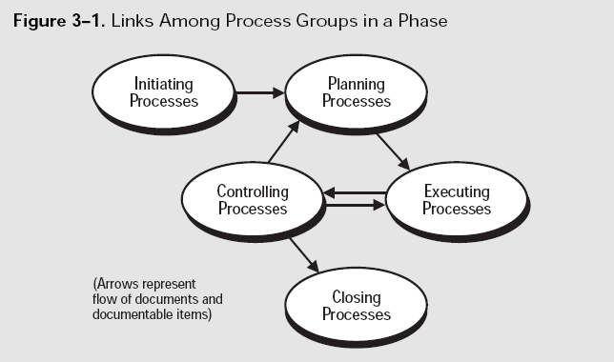
Project Management Processes

Slide 7
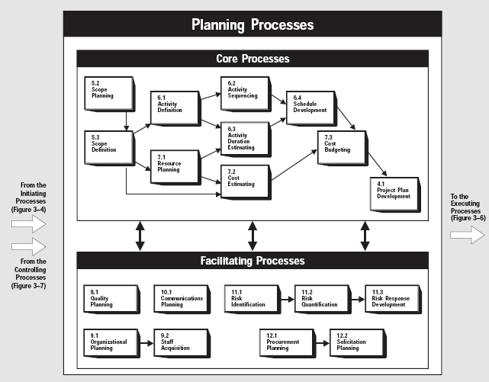
Planning Processes

Slide 8
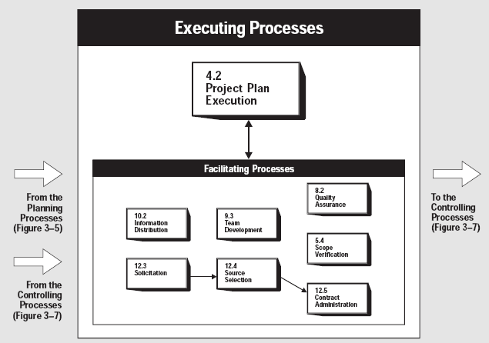
Executing Processes

Slide 9
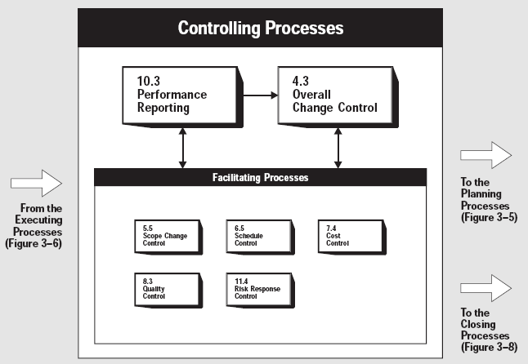
Controlling Processes

Slide 10
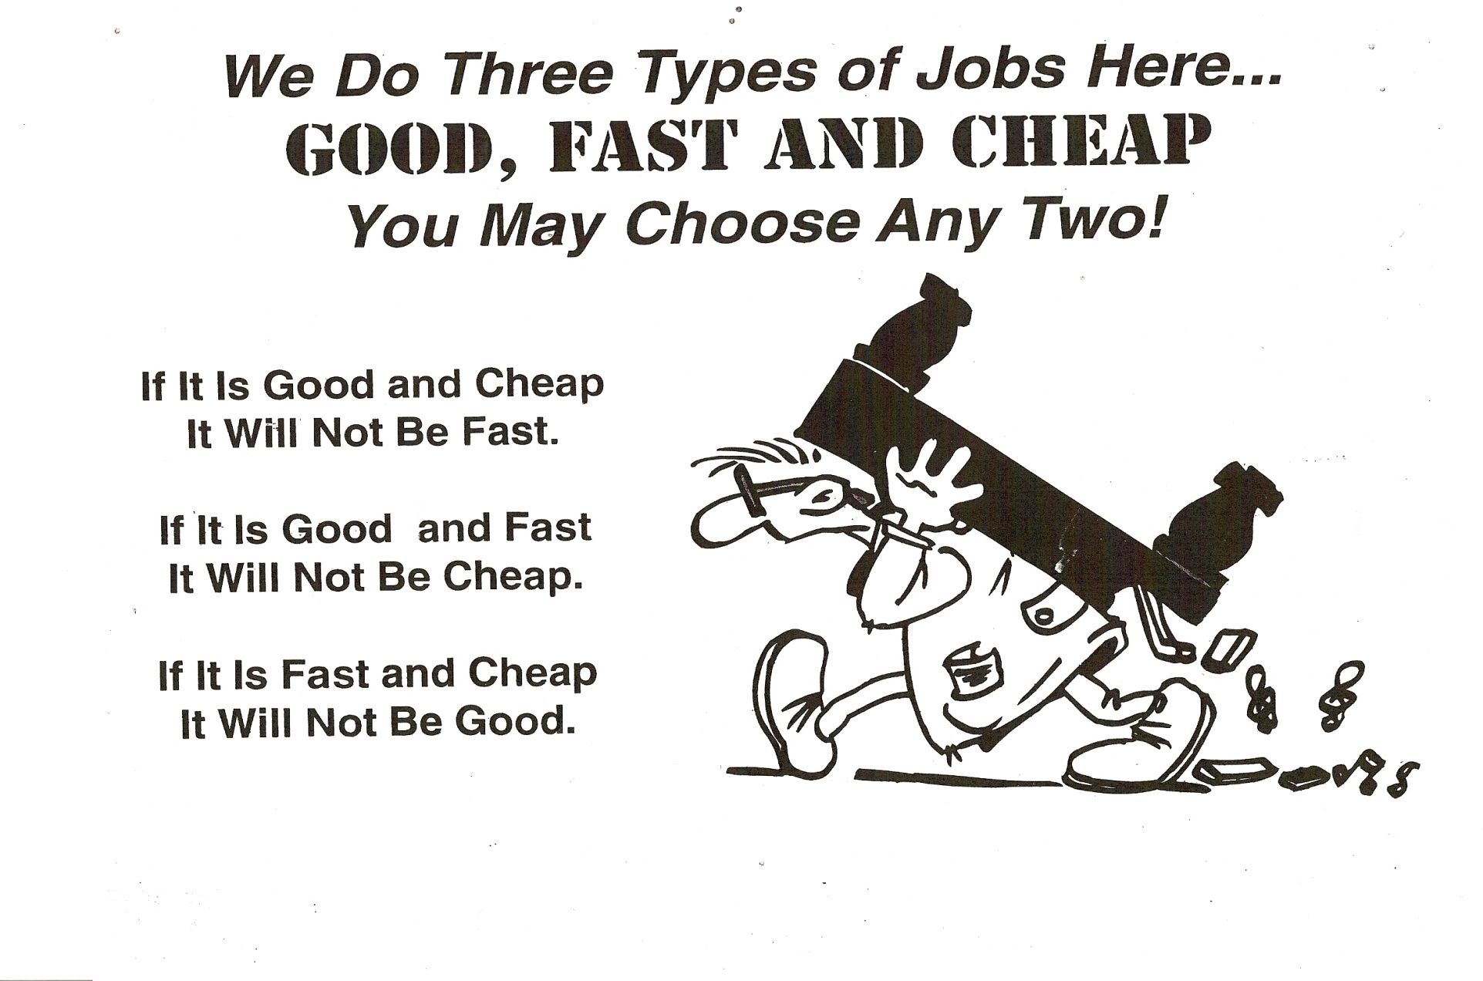
Project Management Wisdom

Slide 11
The Project Management Golden Triangle
Project
Management
Time/Schedule
Money/Budget
Scope/Quality

Slide 12
Project Management Knowledge Areas
Project Scope Management
Project Time Management
Project Quality Management
Project Cost Management
Project Communication Management
Project Risk Management
Project Human Resource Management
Project Procurement Management

Slide 13
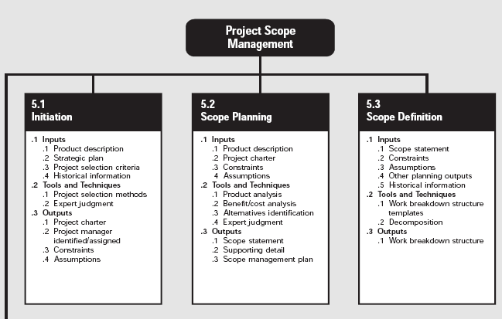
Project Scope Management (1)

Slide 14
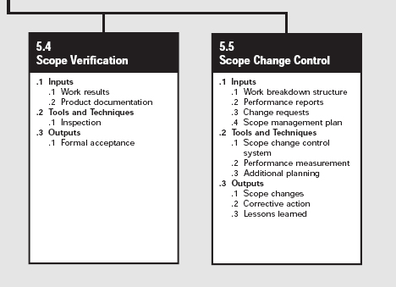
Project Scope Management (2)

Slide 15
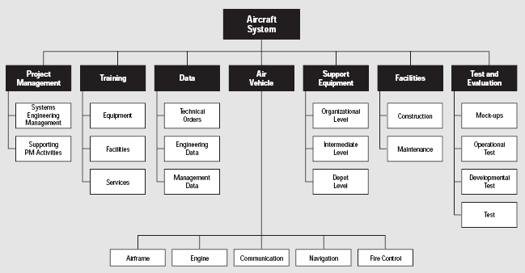
Work Breakdown Structure

Slide 16
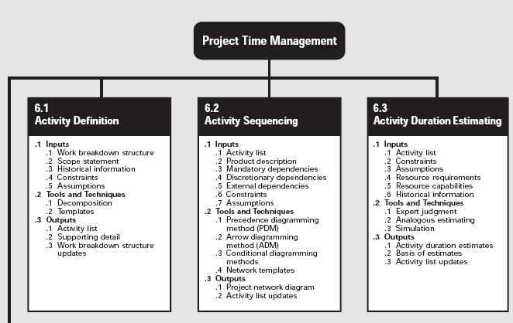
Project Time Management (1)

Slide 17
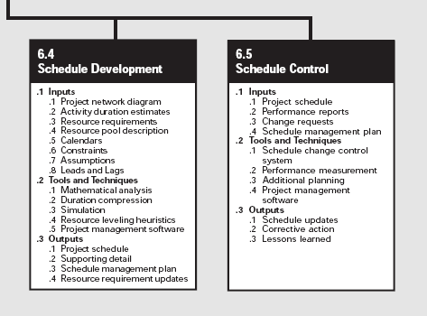
Project Time Management (2)

Slide 18
Activity organization
Activities in a project should be organised to produce tangible outputs for management to judge progress.
Milestones are the end-point of a process activity.
Deliverables are project results delivered to customers.
The waterfall process allows for the straightforward definition of progress milestones.

Slide 19
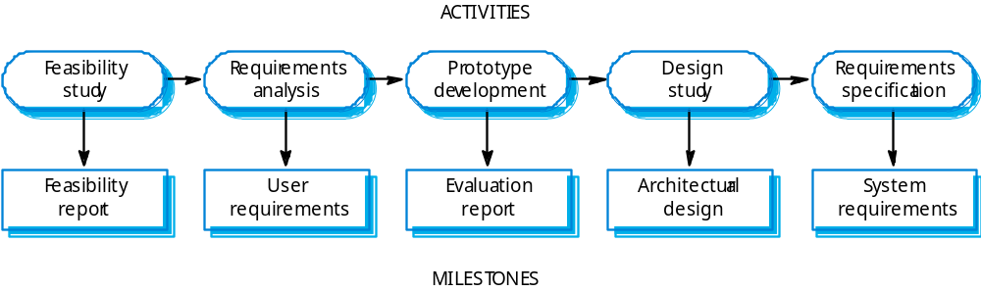
Milestones in the Requirement Engineering process

Slide 20
Project scheduling
Split project into tasks and estimate time and resources required to complete each task.
Organize tasks concurrently to make optimal
use of workforce.
Minimize task dependencies to avoid delays
caused by one task waiting for another to complete.
Dependent on project managers intuition and experience.

Slide 21
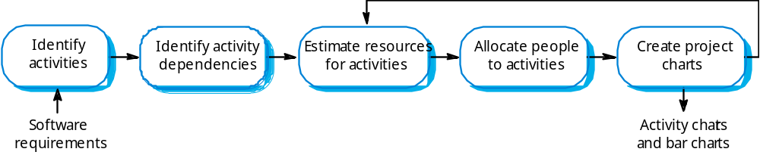
The project scheduling process

Slide 22
Scheduling problems
Estimating the difficulty of problems and hence the cost of developing a solution is hard.
Productivity is not proportional to the number of people working on a task.
Adding people to a late project makes it later because of communication overheads.
The unexpected always happens. Always allow contingency in planning.

Slide 23
Bar charts and activity networks
Graphical notations used to illustrate the project schedule.
Show project breakdown into tasks. Tasks should not be too small. They should take about a week or two.
Activity charts show task dependencies and the the critical path.
Bar charts show schedule against calendar time.

Slide 24
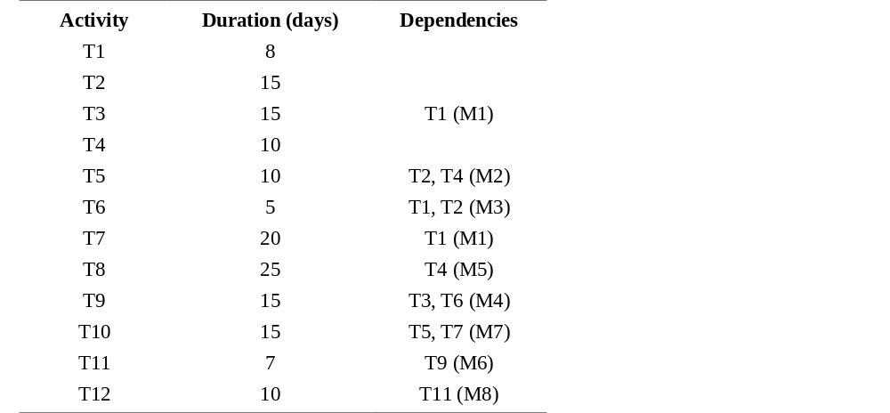
Task durations and dependencies

Slide 25
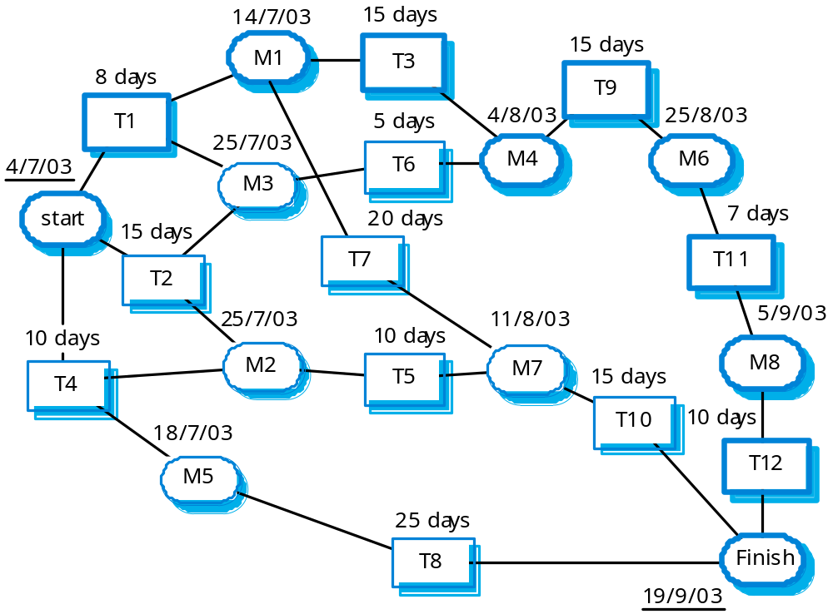
Activity network
Notes:
Path 1: T1->T3->T9->T11->T12 (8+15+15+7+10=55 days)
Path2: T1->T7->T10 (8+20+15=43 days)
Path3: T1->T6->T9->T11->T12 (8+5+15+7+10=45 days)
Path4: T2->T6->T9->T11->T12 (15+5+15+7+10=52 days)
Path5: T2->T5->T10 (15+10+15=40 days)
Path6: T4->T5->T10 (10+10+15=35 days)
Path7: T4->T8 (10+25=35 days)

Slide 26
Critical Path Analysis
How many paths in the activity network (from Start to End)?
7
Which one is the shortest path?
Start->T4->T5->T10->Finish (10+10+15=35 days)
Start->T4->T8->Finish (10+25=35 days)
Which one is the longest path?
T1->T3->T9->T11->T12 (8+15+15+7+10=55 days)
What is the critical path (the longest path)?
T1->T3->T9->T11->T12 (8+15+15+7+10=55 days)
What are the slack time for each path?
Notes:
Path 1: T1->T3->T9->T11->T12 (8+15+15+7+10=55 days)
Path2: T1->T7->T10 (8+20+15=43 days)
Path3: T1->T6->T9->T11->T12 (8+5+15+7+10=45 days)
Path4: T2->T6->T9->T11->T12 (15+5+15+7+10=52 days)
Path5: T2->T5->T10 (15+10+15=40 days)
Path6: T4->T5->T10 (10+10+15=35 days)
Path7: T4->T8 (10+25=35 days)

Slide 27
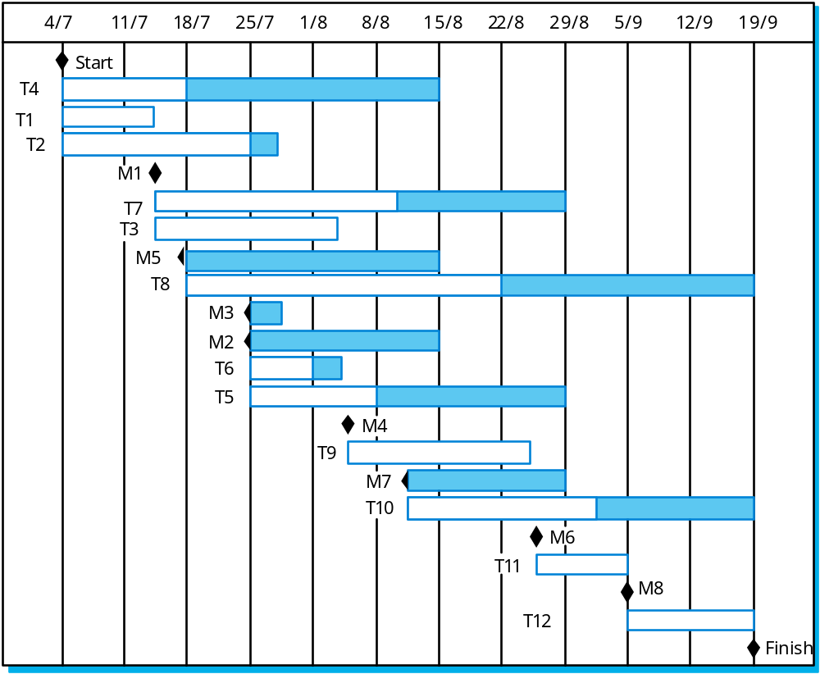
Bar Chart - Activity timeline

Slide 28
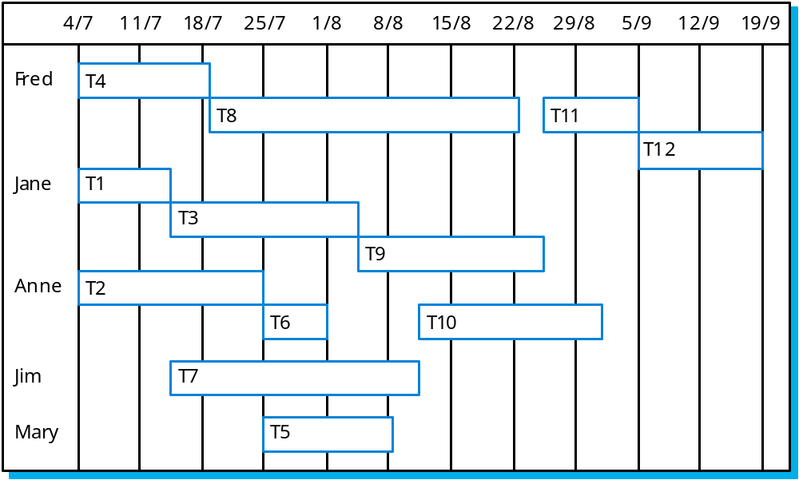
Staff allocation

Slide 29
Key points
Good project management is essential for project success.
The intangible nature of software causes problems for management.
Managers have diverse roles but their most significant activities are planning, estimating and scheduling.
Planning and estimating are iterative processes
which continue throughout the course of a
project.

Slide 30
Key points
A project milestone is a predictable state where a formal report of progress is presented to management.
Project scheduling involves preparing various graphical representations showing project activities, their durations and staffing.
Risk management is concerned with identifying risks which may affect the project and planning to ensure that these risks do not develop into major threats.

